Slide 1

Lecture 05 Two Dimensional Graphics Part 1
Graphics Overview
Working with Geometry
Reference: Java-Tutorials/tutorial-2015/2d/index.html

Slide 2
Why should you study this lecture?
Nowadays, multimedia content is popular
Graphics make a program more attractive
Graphics decrease monotone of designed GUIs which contains text normally

Slide 3
Contents
Graphics Overview
Introduction to Java 2D Graphics
2D Graphics APIs
How to Draw?
Demonstrations

Slide 4
1- Graphics Overview
From Wikipedia
Pixel, picture element: the smallest addressable element in an all points addressable display device; so it is the smallest controllable element of a picture represented on the screen
Representing a pixel: <x, y, color data>
Common representation for color: a triple <red, green, blue>. Value of each component in is in range of 0..255
Raster graphics image: It is a dot matrix data structure representing a generally rectangular grid of pixels, or points of color, viewable via a monitor, paper, or other display medium. Raster images are stored in image files with varying formats (file.bmp, file.png, file.dib, …)

Slide 5
Graphics Overview…
Vector graphics is the use of geometrical primitives such as points, lines, curves, and shapes or polygons—all of which are based on mathematical expressions—to represent images in computer graphics.
Vector graphics are based on vectors (also called paths), which lead through locations called control points or nodes. Each of these points has a definite position on the x and y axes of the work plane and determines the direction of the path; further, each path may be assigned a stroke color, shape, thickness, and fill.
These properties don't increase the size of vector graphics files in a substantial manner, as all information resides in the document's structure, which describes solely how the vector should be drawn.
Vector graphics can be magnified infinitely without loss of quality, while pixel-based graphics cannot.
Notes:
Geometrical ~ Hình học
Primitive ~ Nguyên thuỷ
Curve ~ Đường cong
Shape ~ Khuôn
Polygon ~ Đa giác
A substantial manner ~ Một cách đáng kể
Sodely ~ chỉ
Drawn ~ rút ra
Magnify ~ phóng to
Infinitely ~ một cách vô hạn

Slide 6
Graphics Overview…
Resolution:
(theory) number of pixels per inch (2.54 cm)
(normal) rows*columns of a monitor
Common resolutions: 640x480, 800x600, 1024x768, 1280x800, 3200x2400, …
For more details: https://en.wikipedia.org/wiki/Graphics_display_resolution

Slide 7
Graphics Overview…
Video card: (also called a video adapter, display card, graphics card, graphics board, display adapter, graphics adapter or frame buffer) is an expansion card which generates a feed of output images to a display (such as a computer monitor)
Graphics Accelerate Board: a video card contains a graphical processing unit (GPU) to accelerate graphical presenting
Notes:
- Accelerate ~ Đẩy nhanh

Slide 8

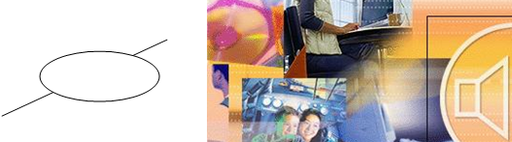
Graphics Overview…
Video modes: Video card can work in two mode:
Text mode: The monitor is divided into a grid of large elements for presenting characters and each character is presented in one element. So, images can not be presented.
Graphic mode: The monitor is divided into a grid of small or tiny elements. So, images can be presented on it.
Text Mode
Graph Mode

Slide 9
Graphics Overview…
Coordinates
0,0
x
y
x
y
Common use co-ordinates
Device co-ordinates
Types of graphics:
Shapes: points, lines, shapes, polygons, colored shapes (vector graphics)
Photos (raster graphics)
Notes:
Ordinate ~ Toạ độ
Co-ordinates ~ Toạ độ chung

Slide 10
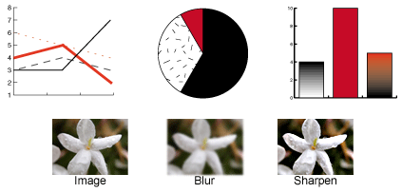
2- Introduction to Java 2D Graphics
Java 2D can:
Draw lines, rectangles and any other geometric shape.
Fill those shapes with solid colors or gradients and textures.
Draw text with options for fine control over the font and rendering process.
Draw images, optionally applying filtering operations.
Apply operations such as compositing and transforming during any of the above rendering operations.

Slide 11
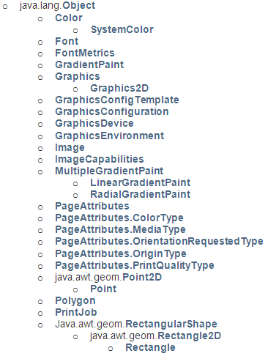

3- Java 2D Graphics APIs
Package java.awt: Basic classes for drawing
The Graphics, Graphics2D classes are abstract
➔ we can not use it directly.
Each class representing a component in the packages java.awt, javax.swing implemented the method getGrahics() to get the appropriate concrete graphic objects which associate with it. This component plays a role as a drawing frame.
Casting a Graphics object to get a Graphics2D object.

Slide 12
Java 2D Graphics APIs…
Package java.awt.geom: concrete classes for geometry
AffineTransform
Area
CubicCurve2D
CubicCurve2D.Double
CubicCurve2D.Float
Dimension2D
FlatteningPathIterator
Line2D
Line2D.Double
Line2D.Float
Path2D
Path2D.Double
Path2D.Float
GeneralPath
Point2D
Point2D.Double
Point2D.Float
QuadCurve2D
QuadCurve2D.Double
QuadCurve2D.Float
RectangularShape
Arc2D
Arc2D.Double
Arc2D.Float
Ellipse2D
Ellipse2D.Double
Ellipse2D.Float
Rectangle2D
Rectangle2D.Double
Rectangle2D.Float
RoundRectangle2D
RoundRectangle2D.Double
RoundRectangle2D.Float
Quadratic: A curve of the second degree
Cubic Curves: A curve of the third degree

Slide 13
Graphics versus Graphics2D
void drawLine(int x1, int y1, int x2, int y2)
void drawOval(int x, int y, int width, int height)
void drawPolygon(int[] xPoints, int[] yPoints, int nPoints).
void drawPolygon(Polygon p)
void drawPolyline(int[] xPoints, int[] yPoints, int nPoints)
void drawRect(int x, int y, int width, int height)
void drawRoundRect(int x,int y,int width,int height,int arcWidth,int arcHeight)
The Graphics class has drawing methods based on values
void draw(Shape s)
void clip(Shape s)
void fill(Shape s)
void rotate(double theta)
void rotate(double theta, double x, double y)
void scale(double sx, double sy)
void shear(double shx, double shy)
void transform(AffineTransform Tx)
void translate(double tx, double ty)
void translate(int x, int y)
The Graphics class inherits methods from the Graphics class and drawing methods based on shape objects and special methods are implemented such as rotate (quay ảnh), scale(co dãn), shear(làm nghiêng) , transform (biến hình), translate (chuyển dịch điểm)

Slide 14
The java.awt.Color Class
Static constants for basic colors: black, BLACK, red, RED, pink, PINK, orange, ORANGE, …
Common Constructors:
Color(int r, int g, int b), range 0-255
Color(int r, int g, int b, int a), r, g, b, alpha: 0-255
Color(float r, float g, float b), range: 0.0 - 1.0
Color(float r, float g, float b, float a), range 0.0-1.0
Alpha: level of transparency

Slide 15
4- How to Draw?
Drawing as soon as GUIs appear:
Overide the method paint(Graphics g). This method will be called as default when the class is loaded to draw it.
Re-draw:
- Call the method update(Graphics g) or repaint(void)
Free Drawing:
Graphics g = Component.getGraphics();
g.drawXXX(params)

Slide 16
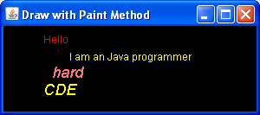
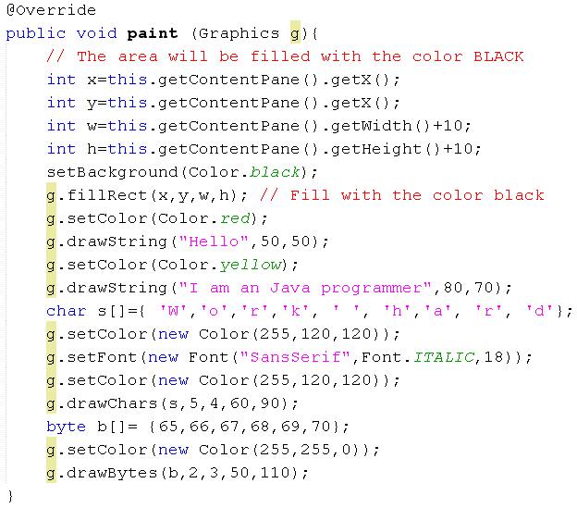

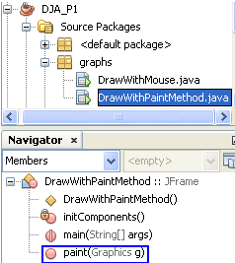
Demo 1: Using the method paint(…)
Frame properties:
title: Draw with Paint Method
Layout: Border
Size: 300, 150

Slide 17
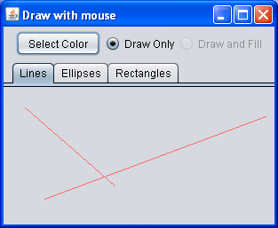
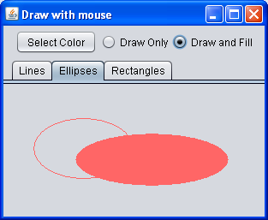
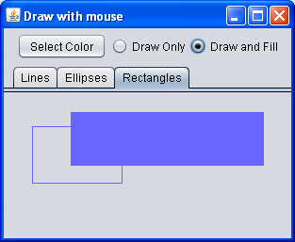
Demo 2: Drawing with Mouse
The following demonstration will depict how to draw shapes using mouse events.
A shape is determined by two points: p1 (when user presses the mouse) and p2 (when user releases the mouse).
If an ellipse or a rectangle is chosen, from p1 and p2, the drawing area is determined appropriately.
Left,top
width
p2
height
p1

Slide 18
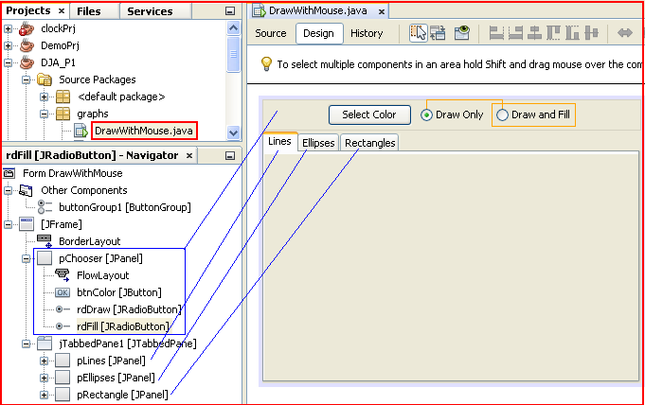
Demo 2: Design
Frame properties
Title: Draw with mouse
The panel pChooser is put to the direction NORTH of the frame
The tabbedpane jTabbedPane1 is put to the direction CENTER of the frame

Slide 19
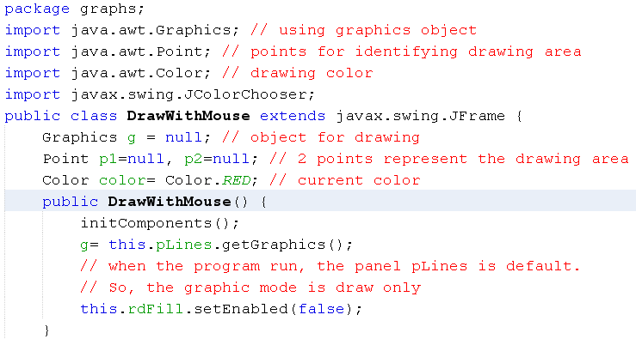
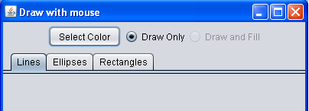
Demo 2: Code

Slide 20
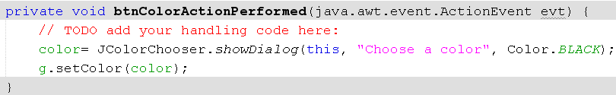

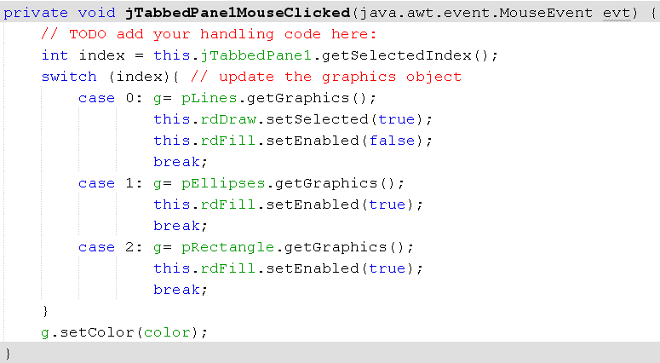
Demo 2: Code

Slide 21

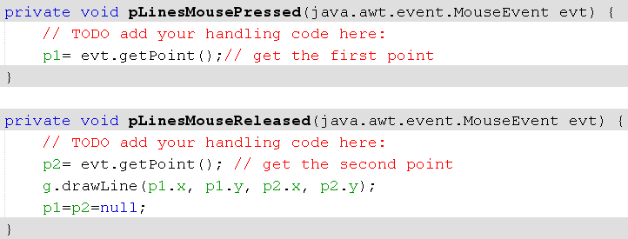
Demo 2: Code

Slide 22


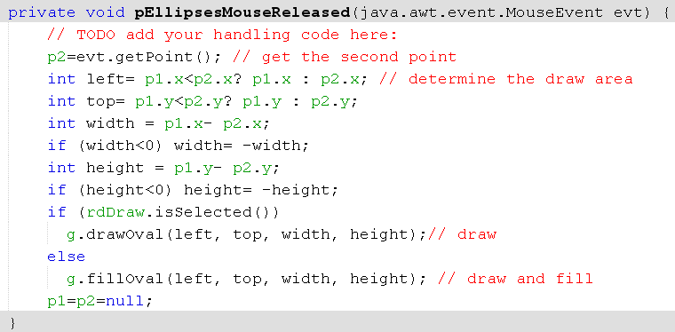
Demo 2: Code

Slide 23


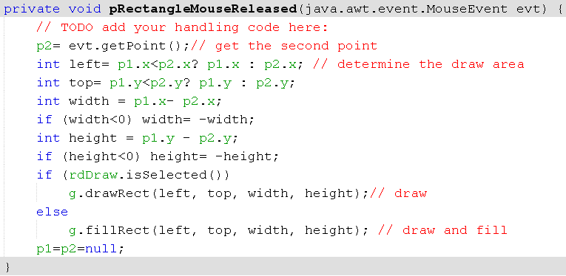
Demo 2: Code

Slide 24
Summary
Graphics Overview
Introduction to Java 2D Graphics
2D Graphics APIs
How to Draw?
Demonstrations

Slide 25
Thank You

